Slide 1

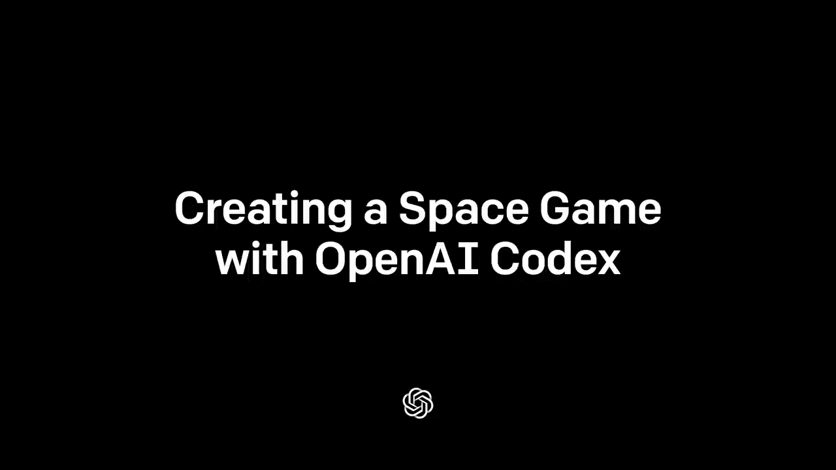
Как изменится программирование в ближайшие 5-10 лет
Dmitry Ivanov, korifey@gmail.com, @korifey_ad, github.com/korifey/talks

Slide 2
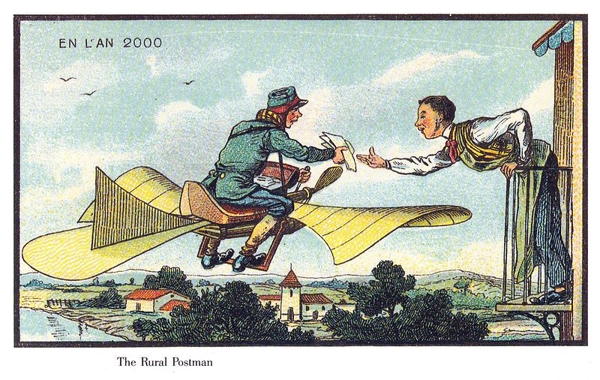
Notes:
Смешная картинка с прогнозами будущего

Slide 3
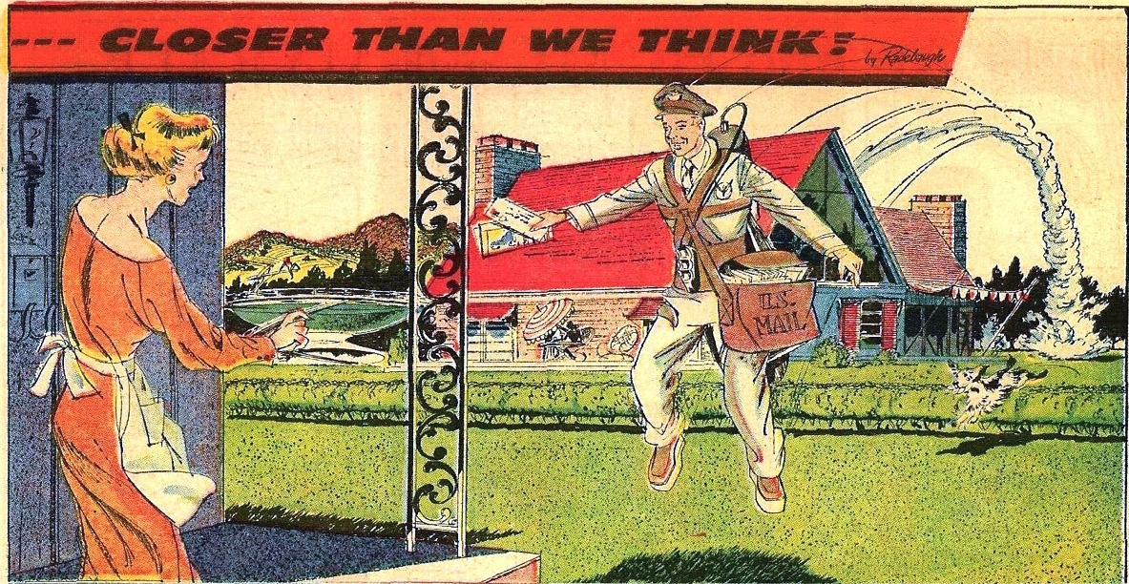

Slide 4
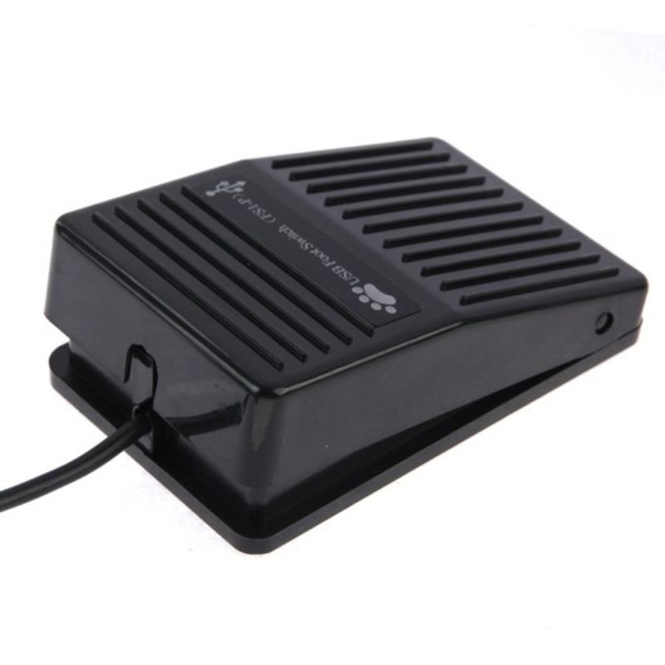

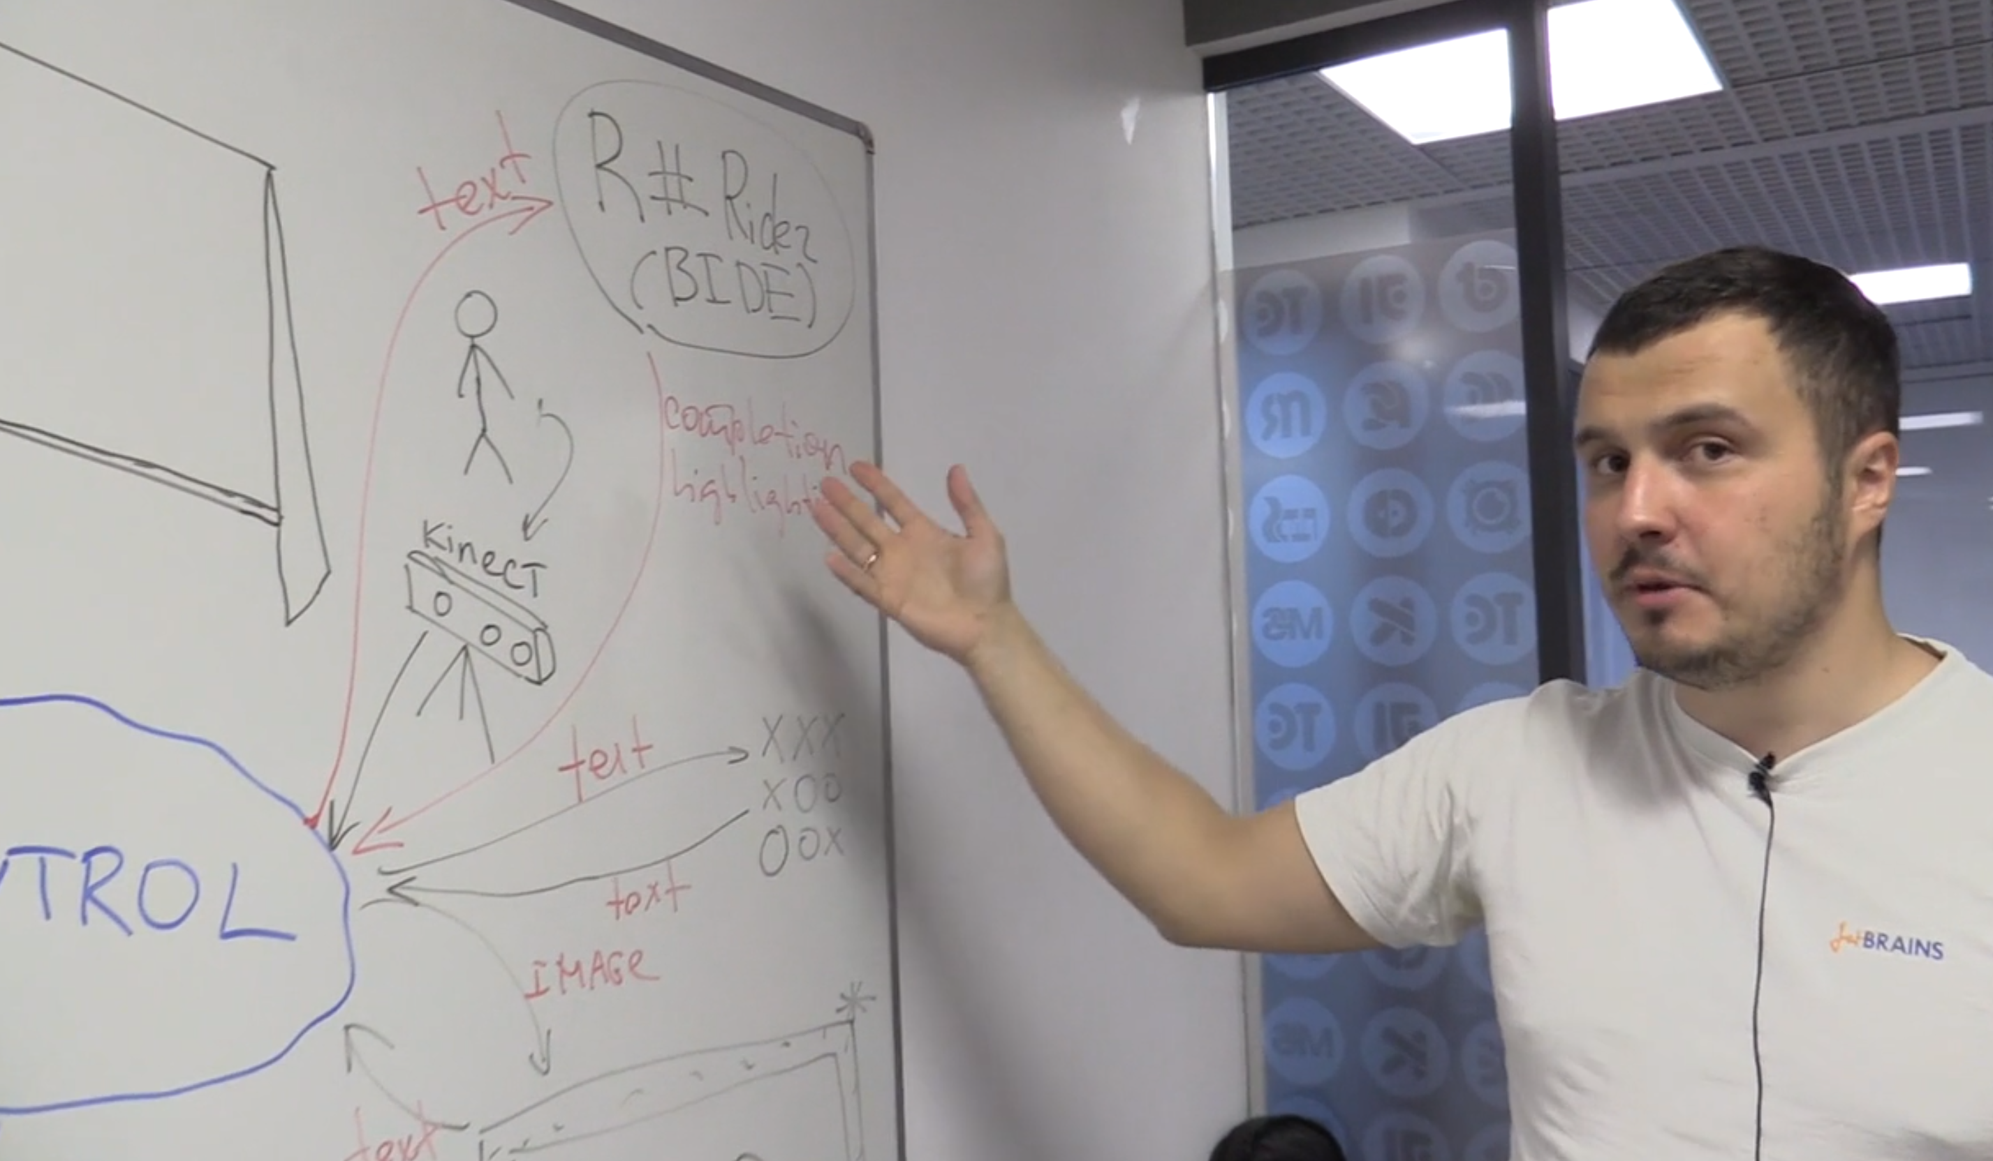
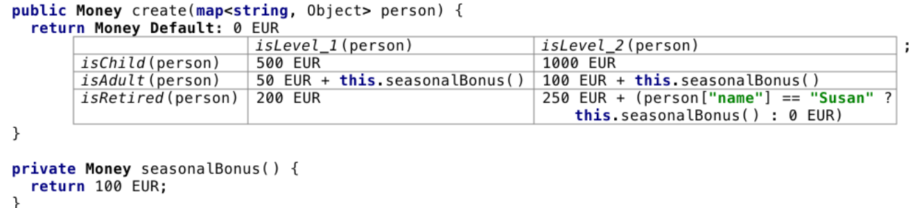
Notes:
Распознавание голоса, педаль, Педаль, whiteboard IDE, MPS

Slide 5

Notes:
Facebook Metaverse

Slide 6
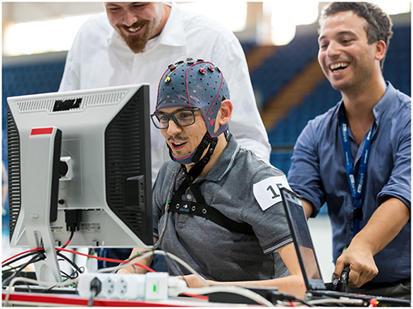
Notes:
Matrix

Slide 7
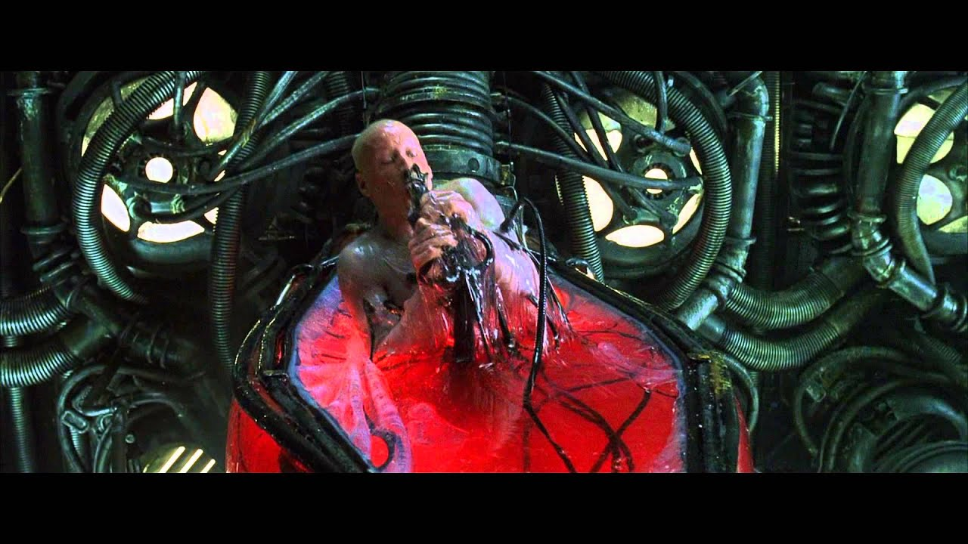
Notes:
Matrix

Slide 8
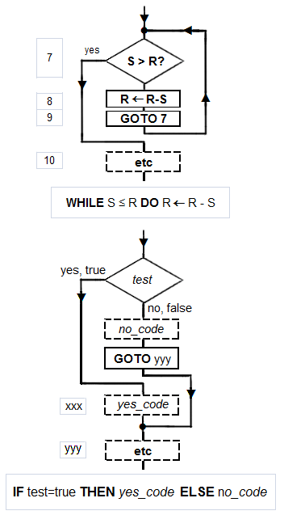
Notes:
No Code, UML

Slide 9
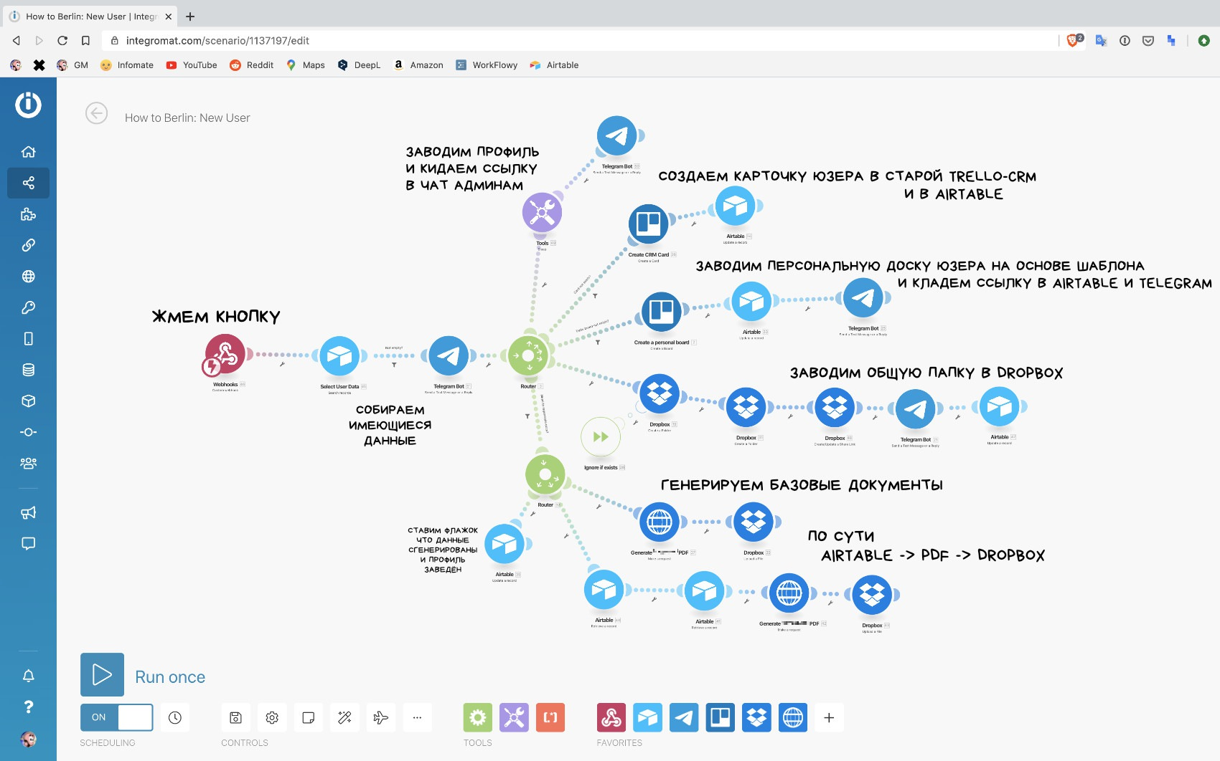
Источник: https://vas3k.ru/blog/nocode/
Notes:
No Code, UML

Slide 10
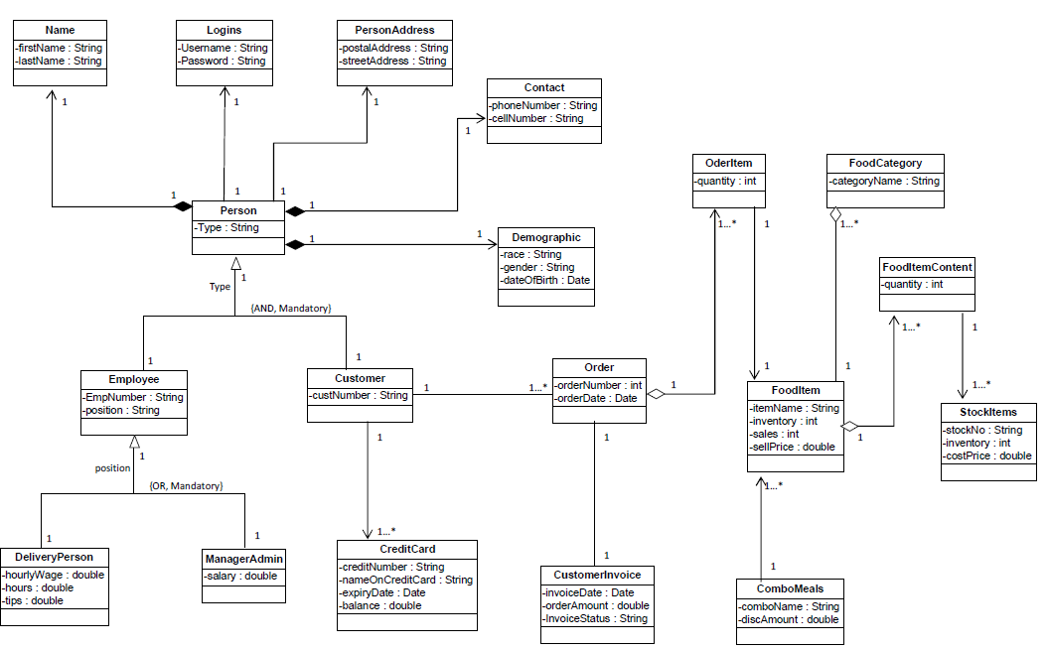
UML
Notes:
Кривая Хайпа

Slide 11
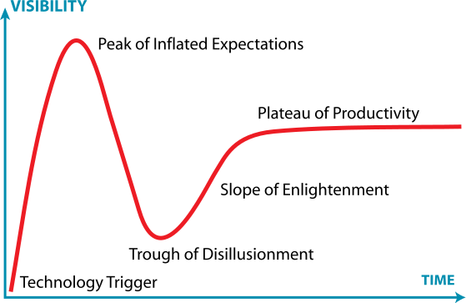

Slide 12
PART I : IDE

Slide 13
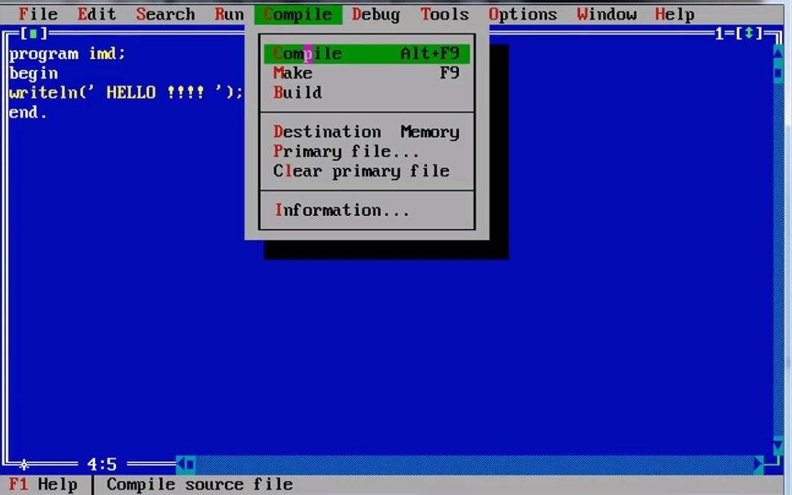



1st generation of IDE: 1970s-1990s
Examples:
Turbo Pascal
Turbo C/C++
Borland Delphi

Slide 14
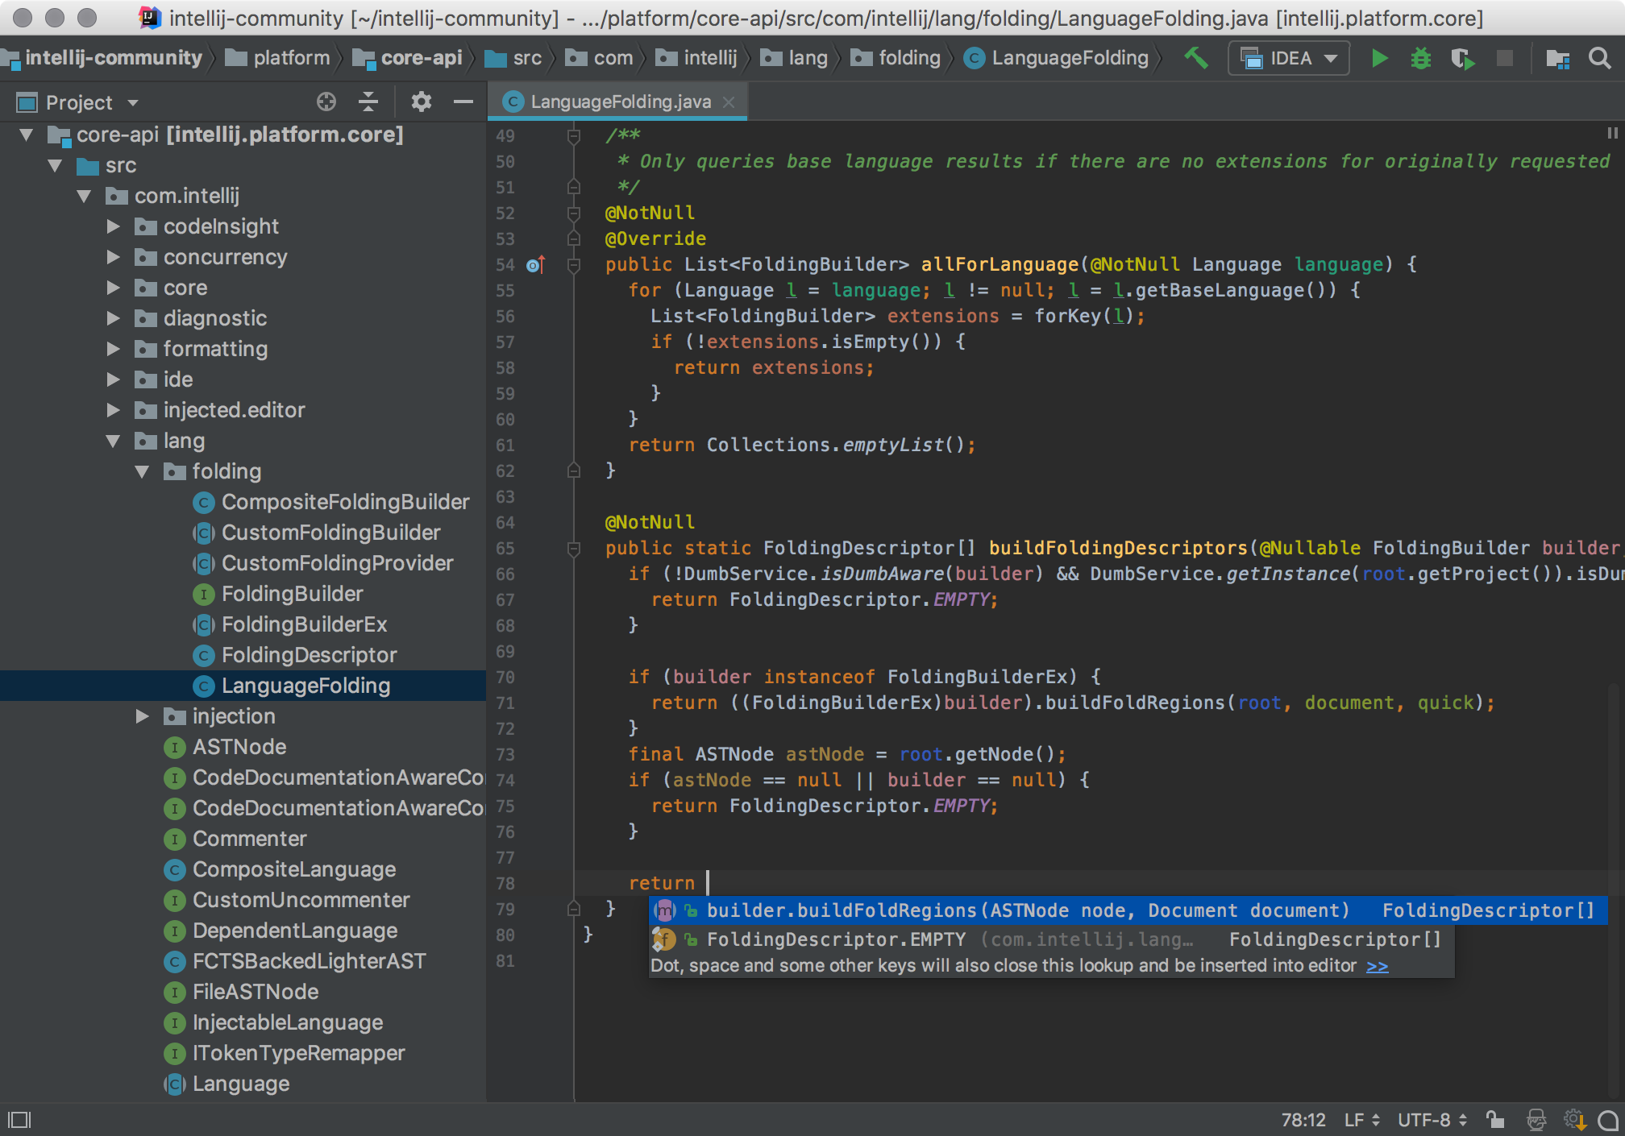
2nd generation of IDE: 2000s
Examples:
IntellijIDEA
Eclipse
Features
Completion
Error highlighting
Refactoring
Quickfix
… any 100+ more

Slide 15
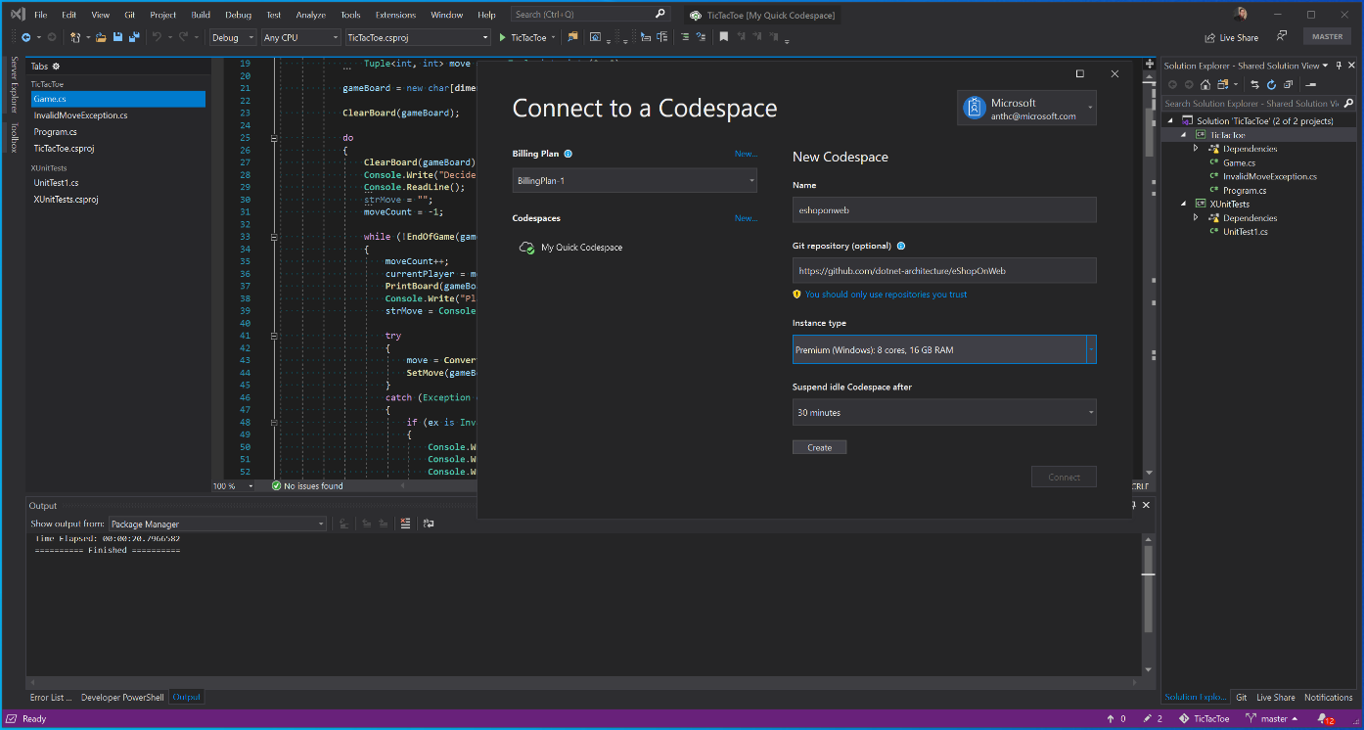
2+^{nd} generation of IDE: 2010s
Lightweight IDEs – separate editor and language server
Vim
Emacs
Sublime
Visual Studio Code
LSP - Language server protocol
Browser/Desktop - Visual Studio Codespaces
Collaborative editing -Live Share

Slide 16









Application Lifecycle Management

Slide 17
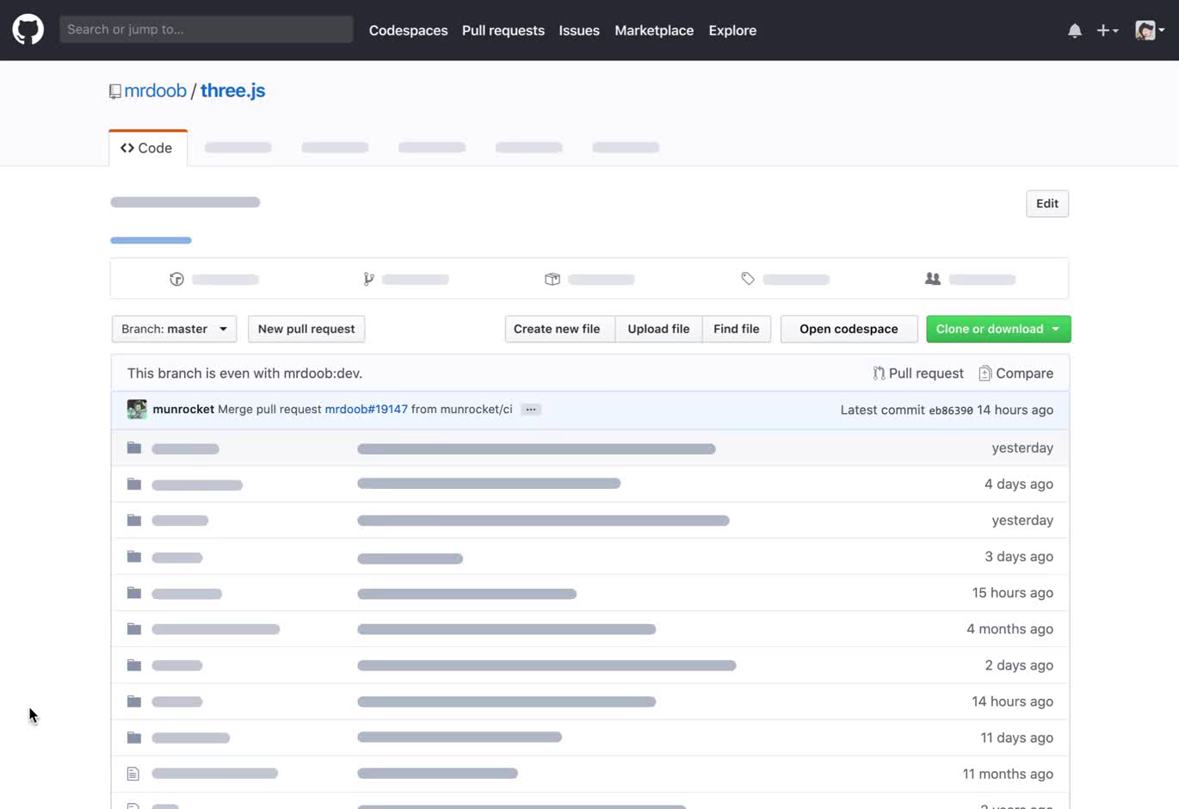
Isomorphic experience of IDE and ALM
IDE
All-in-one
tool
ALM

Slide 18

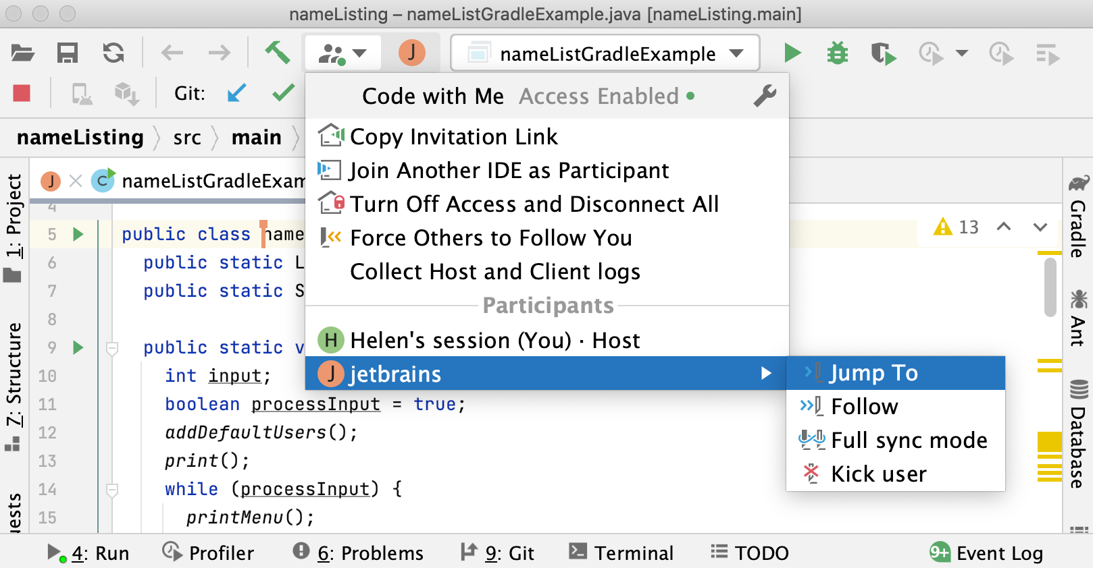

Collaborative editing
Cloud / On Premise
Download Server
JetBrains CodeWithMe
User send link for collaborator to join
Collaborator open link, downloads IntellijClient and start working on same project
THIN
CLIENT
share link
User1
User2
Ask FS and code model

Slide 19
Hybrid: Cloud + 2nd gen IDE
JetBrains CodeWithMe
User send link for collaborator to join
Collaborator open link, downloads IntellijClient and start working on same project
DevCloud
VirtualMachine
CloneOfRep
IntellijServer
Possible integration with ALM (DevCloud)
Button (Open codespace) in DevCloud that creates cloud virtual machine
Intellij Server is started on this VM
Everyone who have link can connect (multiple users)
Full power of IDE is available in Cloud
ThinClient
ThinClient
Share Link
User
User

Slide 20
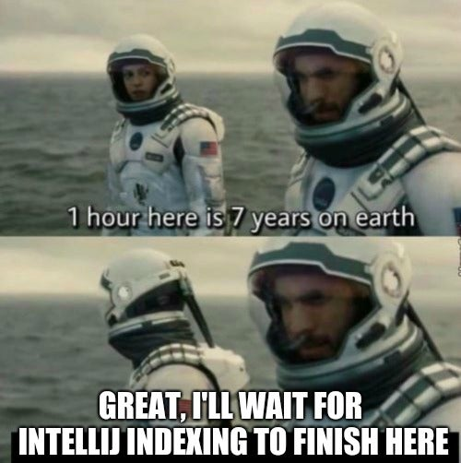

Slide 21
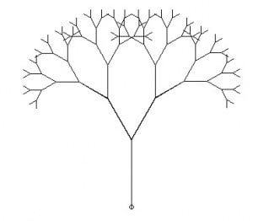



Zero-time setup
Developer can click 1 link and get ready environment in several seconds
IMMUTABLE TREE
DOWNLOAD
“Open IDE here“
INDEXES
FILESYSTEM
BUILD ARTIFACTS
NEXTGEN
CODE REVIEW

Slide 22
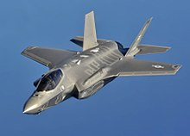
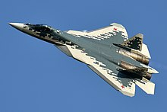
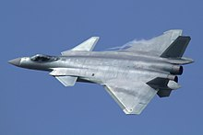
What is IDE of 3rd generation?
What is 5th generation jet fighter?
All aspect stealth – even when armed (LPIR)
High maneuverability
Advanced avionics
Multirole capabilities
Highly integrated computer systems capable of networking with other elements within battlespace

Slide 23
PART II : LANGUAGE

Slide 24

Multi-paradigm programming language
int totalSalary = 0; for (Human h: humans) { if (h.age >= 18) totalSalary += h.salary; } return totalSalary;
return humans.stream() .filter(h -> h.age >= 18) .map(h->h.age) .reduce(0, Integer::sum);

Slide 25

Logic programming
FACTS
QUERIES
:- bro(dima, sasha).
:- bro(sasha, petya).
?-: bro (dima, X).
X = sasha
?-: bro (petya, X).
No
RULES
bro(X, Y) :- bro(Y, Z).
?-: bro (petya, X).
X = sasha
bro(X, Z) :- bro(X, Y), bro(Y, Z).
X = dima
bro(X, X) :- false.

Slide 26
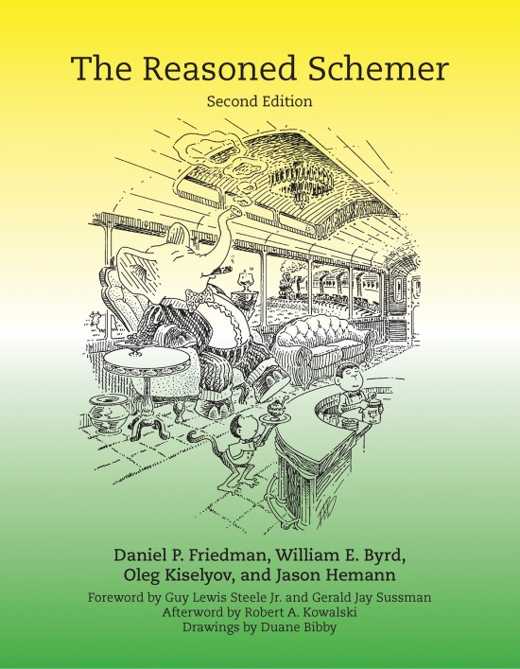
Relational programming & miniKanren
DSL for logic programming
Host languages:
SCHEME
JAVA
KOTLIN
JAVA
C#
JAVASCRIPT
GO
….
mul(2, 3, 6)
?:- mul(2, 3, X) -> 6
?:- mul(2, X, 5) -> 3
?:- mul(X, 2, 5) -> 2
WHAT INSTEAD OF HOW

Slide 27
Regex r = Regex.compile(“-?([1-9])[0-9]*|0”)
r.matches(“-0”)
YES
Match m = r.matches(“420”);
m.get(1);
$1 = “4”
m.generate()
-123

Slide 28
OCanren
https://github.com/JetBrains-Research/OCanren, Boulytchev, SpbU
INTERPRET(program, input, output)
INTERPRET(program, input, Output)
Forward execution
INTERPRET(program, Input, output)
Backward execution
INTERPRET(Program, input, output)
Program synthesis

Slide 29
Synthesis by verification in OCanren
Input
Output
5 litres
4 litres
3 litres
0 litres
Program = [(water 5 in, water 3 in, water 5 out, water 3 out)]
Verifier = fill 5 | fill 3 | 5 -> 3 | 3 -> 5 | empty 5 | empty 3)
fill 5 :- (_, 3, 5, 3)

Slide 30
PART I I I : ANALYSIS AND SYNTHESIS

Slide 31
Synthesis by verification
String s = <concatenate>(x,y);
assert(
s.length == x.length + y.length
&& s.startsWith(x)
&& s.endsWith(y)
)

Slide 32
Analysis
String s = concatenate(x, y)
assert(
s.length == x.length + y.length
&& s.startsWith(x)
&& s.endsWith(y)
)

Slide 33
Property-based testing
String s = concatenate(x, y)
assert(
s.length == x.length + y.length
&& s.startsWith(x)
&& s.endsWith(y)
)
Fuzz x, y
Found assertion violation
Minimize x, y
QuickCheck

Slide 34
Symbolic testing
String s = concatenate(x, y)
assert(
s.length == x.length + y.length
&& s.startsWith(x)
&& s.endsWith(y)
)
Execute all possible paths
Found assertion violation
Java Symbolic Path Finder

Slide 35
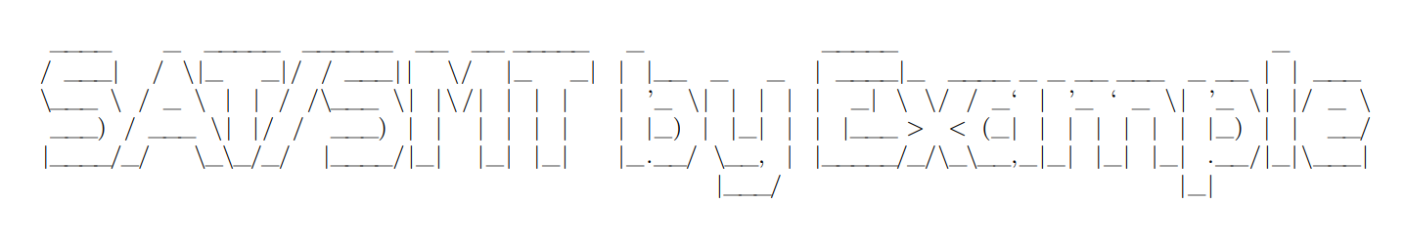
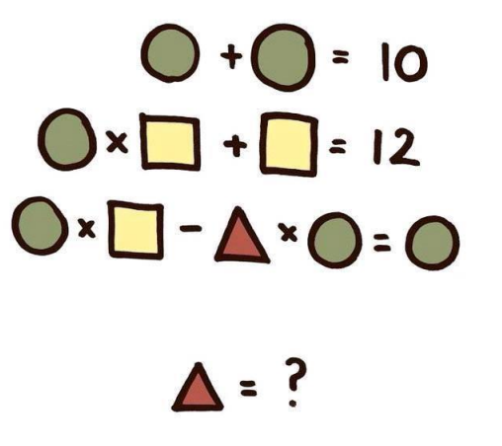
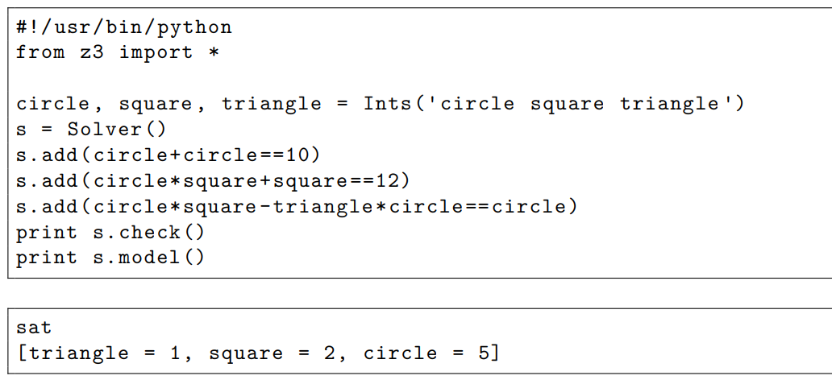

Slide 36
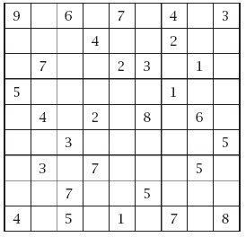
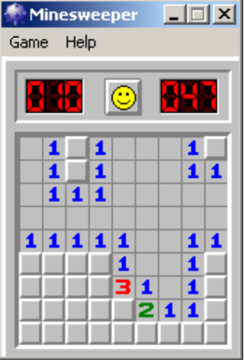

Slide 37
Next decade opportunities for synthesis
Formal
requirements
UML diagrams,
models, docs
Informal
requirements
Code
Client
Analysts
Architects
Developer
QA
Model checking
Program synthesis
Code generation
Software analisys
Test generation
TESTS
ML
Advanced synthesis
PROD

Slide 38
Program Synthesis Birdeye View
Formal specification
PROGRAM
SYNTHESIS
Program
space
search in
Provided examples
Program
Guessed user intent
Test generation
Superoptimization
Deobfuscation

Slide 39
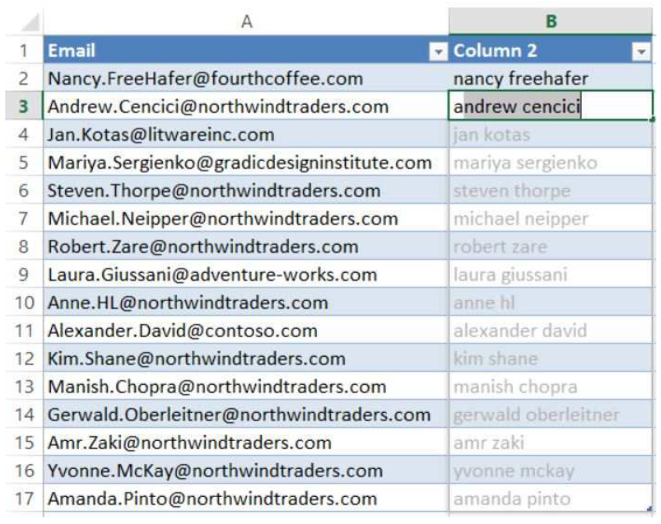
Programming by Example: FlashFill in Excel
Excel automatically syntheses the formula Concatenate(ToLower(Substring(v, WordToken, 1)), “ ”, ToLower(Substring(v, WordToken, 2)))

Slide 40
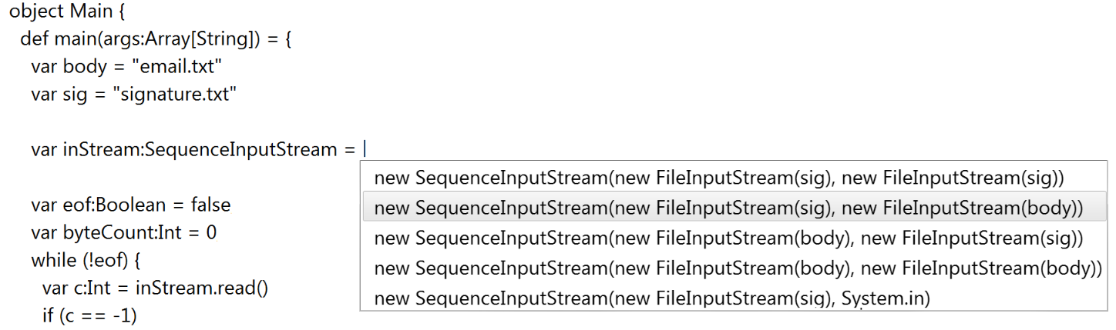
Code Completion
Formal specification: code compiles
Guessed user intent:
- Probability of each expression in program
Provided examples: statistics of previous completions

Slide 41
Epilogue: Live demo

Slide 42

Thanks for you attention
Futuredays: A Nineteenth Century Vision of the Year 2000 by Jean Marc Cote, Isaac Asimov
Daniel P. Friedman, William E. Byrd, Oleg Kiselyov, and Jason Hemann, The Reasoned Schemer, Second Edition
https://github.com/JetBrains-Research/OCanren
“SAT/SMT by Example”
Program Synthesis: Opportunities for the Next Decade
Utbot.org
Dmitry Ivanov, korifey@gmail.com, @korifey_ad, github.com/korifey/talks

